Slide 1

Data Sourcing

Slide 2
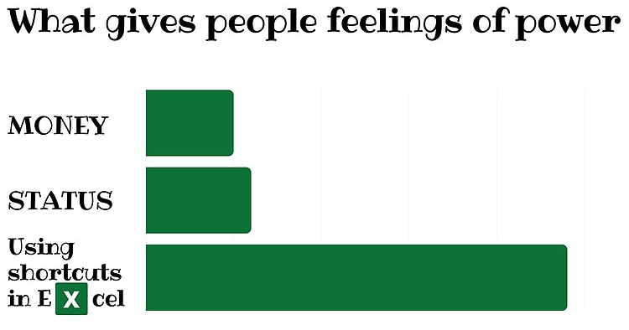
Daily Agenda
Describe the data life cycle (5 min)
Discuss data sourcing considerations (15 min)
Explore publicly-available environmental datasets (10 min)
Write quality metadata (10 min)
Learn Excel tips for data entry and validation (40 min)

Slide 3
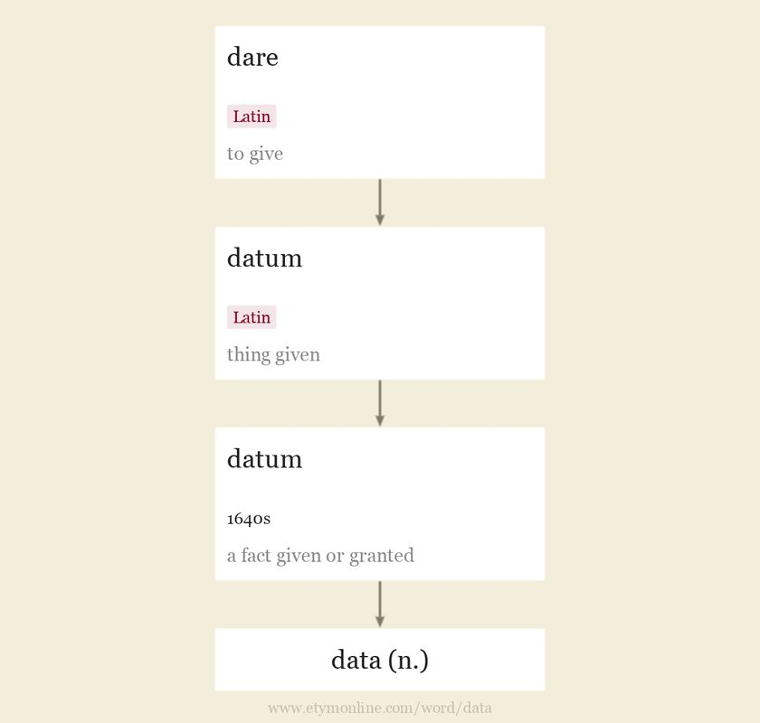
Singular
Plural

Slide 4
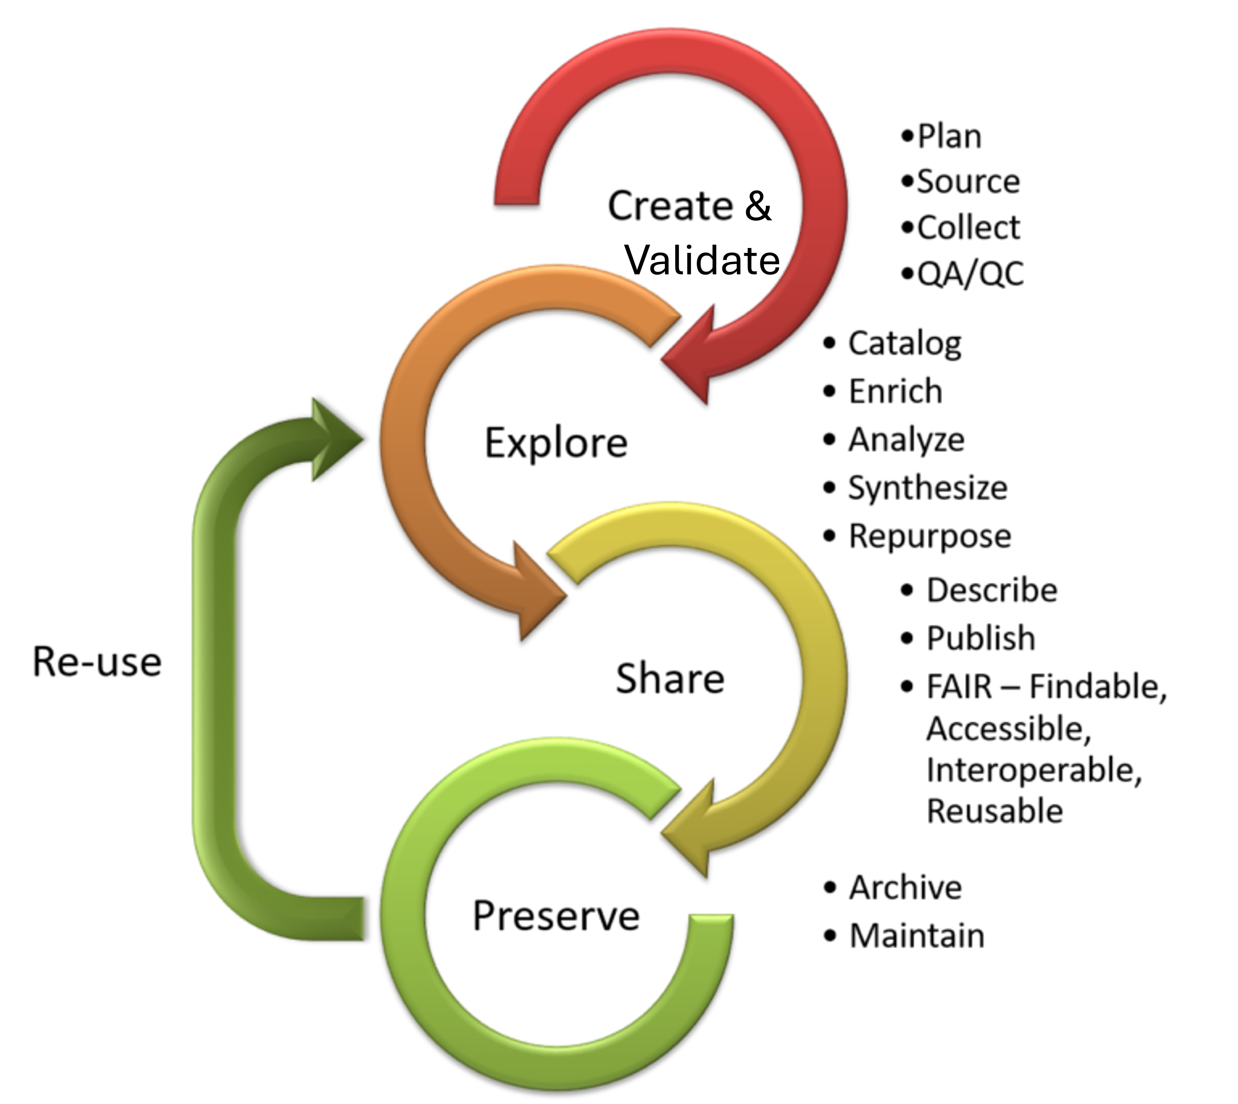
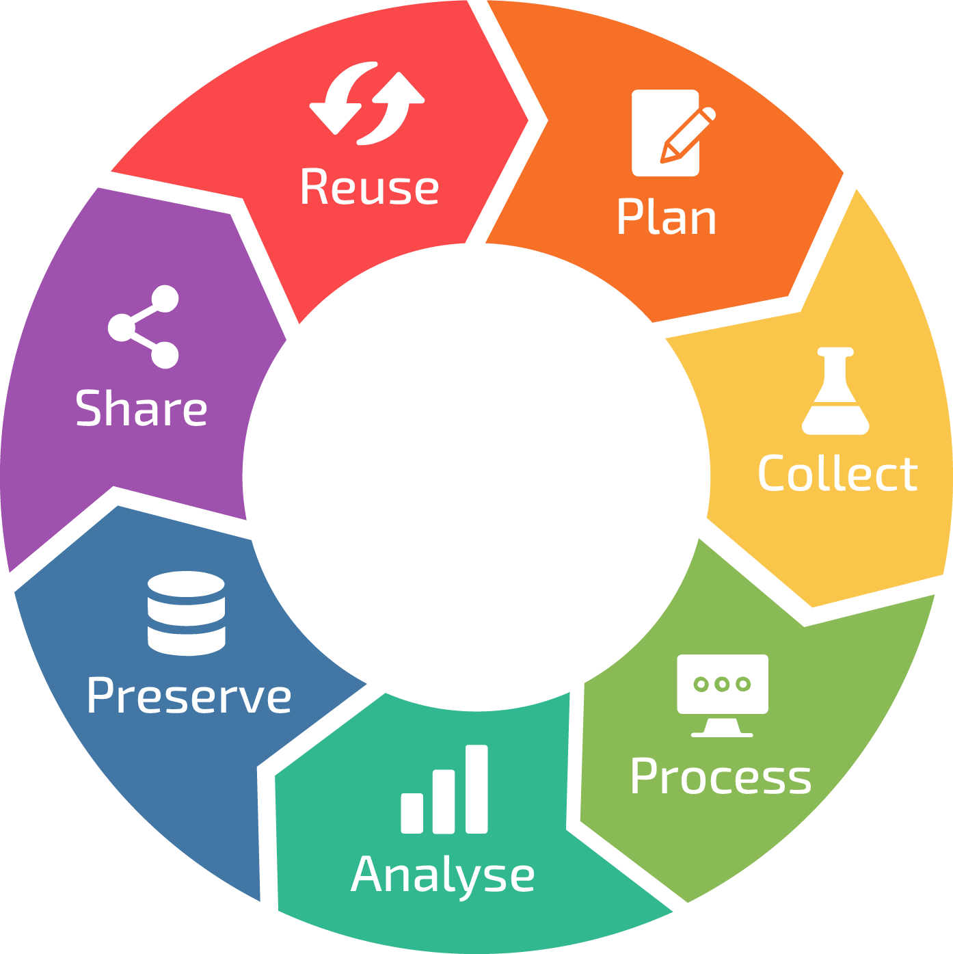
Data Life Cycle
Week 3
Week 4

Slide 5
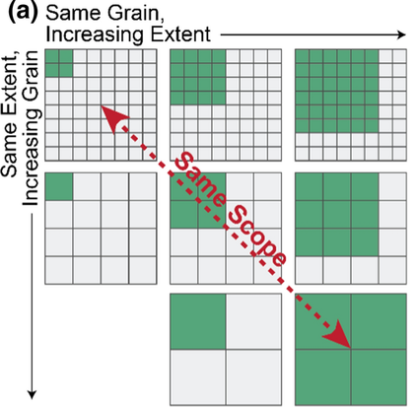
Data Relevance
Do the data directly address the analytical needs or purpose of the study?
Are the variables sufficiently granular?
Are the temporal and spatial scales appropriate?
Do the data adequately represent the population, area, or system of interest?
Frazier 2022 Landscape Ecology

Slide 6
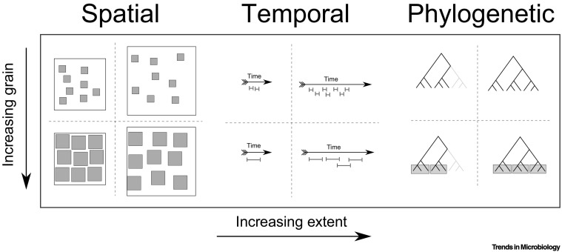

Slide 7
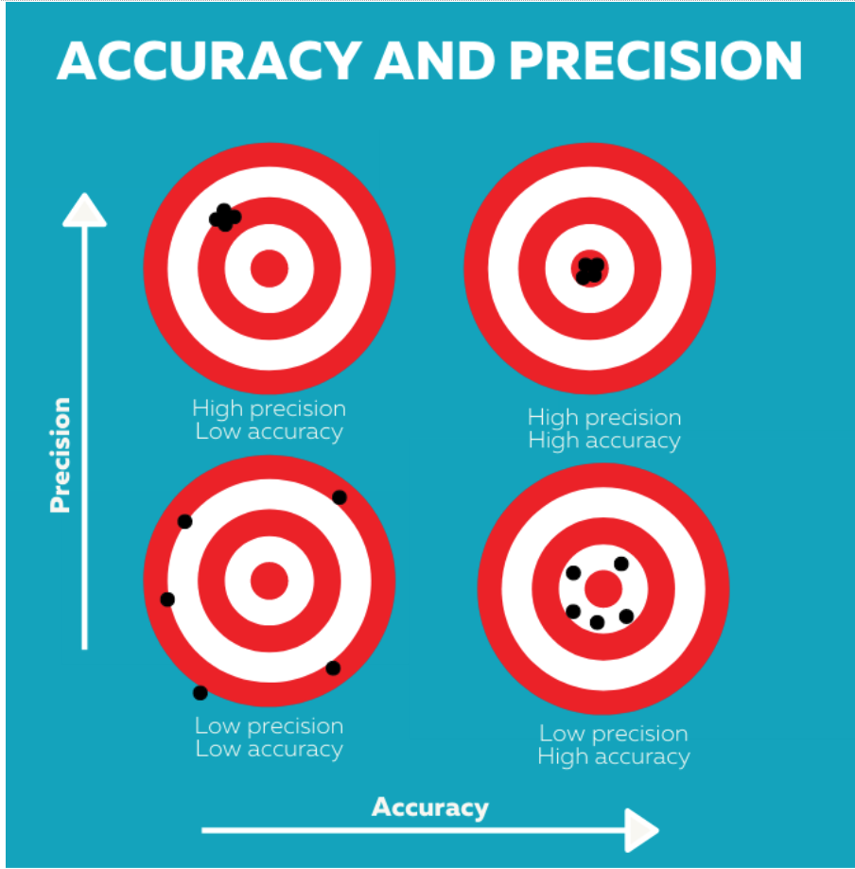
Data Quality and Reliability
Are the data from a reputable organization or do they have a well-documented origin?
Are the measurements collected precisely and accurately?
Are there known sources of error?
Are there missing values or large gaps in space and time?

Slide 8
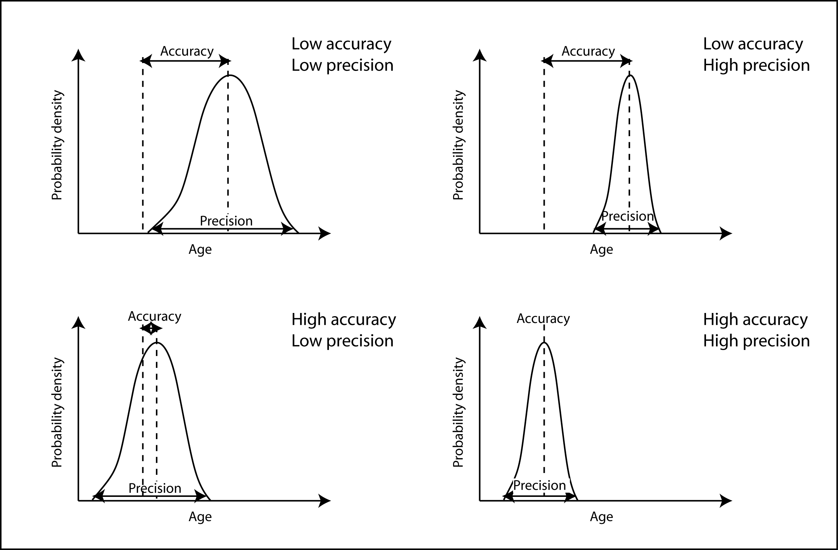
True population mean

Slide 9
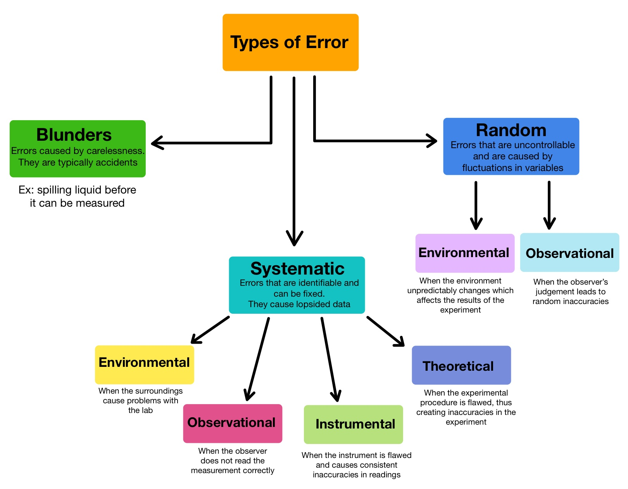

Slide 10
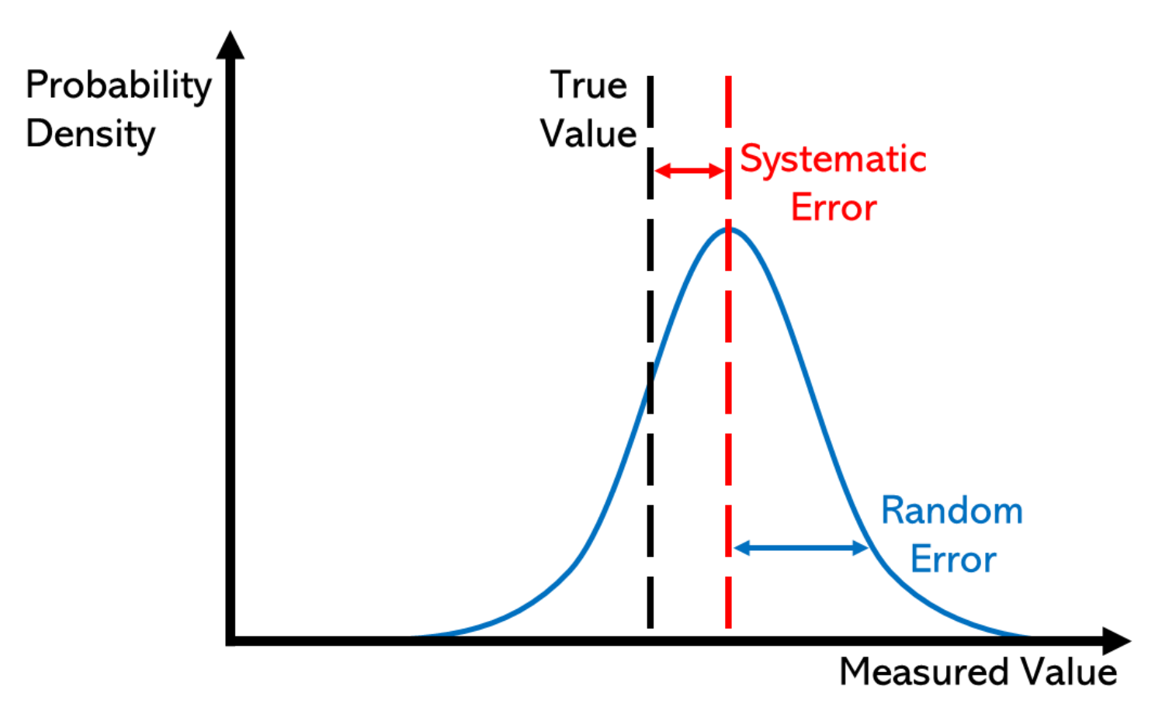

Slide 11
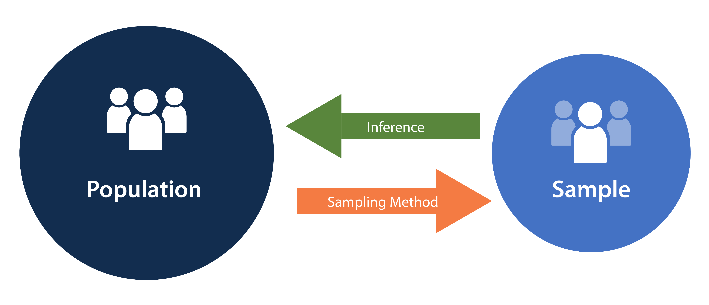
Bias and Representativeness
Is the sampling or treatment assignment strategy appropriate for the research questions?
Do the data reflect a sample from a broader population?
Were certain groups or locations more likely to be sampled; i.e., was there selection bias?

Slide 12
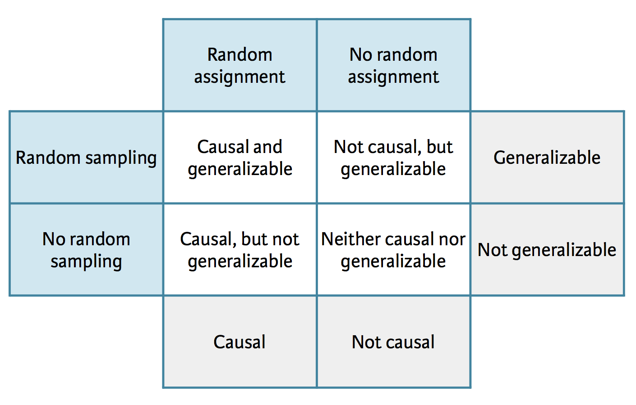
Gold standard for experiments
Good protocol for observational studies
Acceptable for experiments
Poor protocol for observational studies

Slide 13
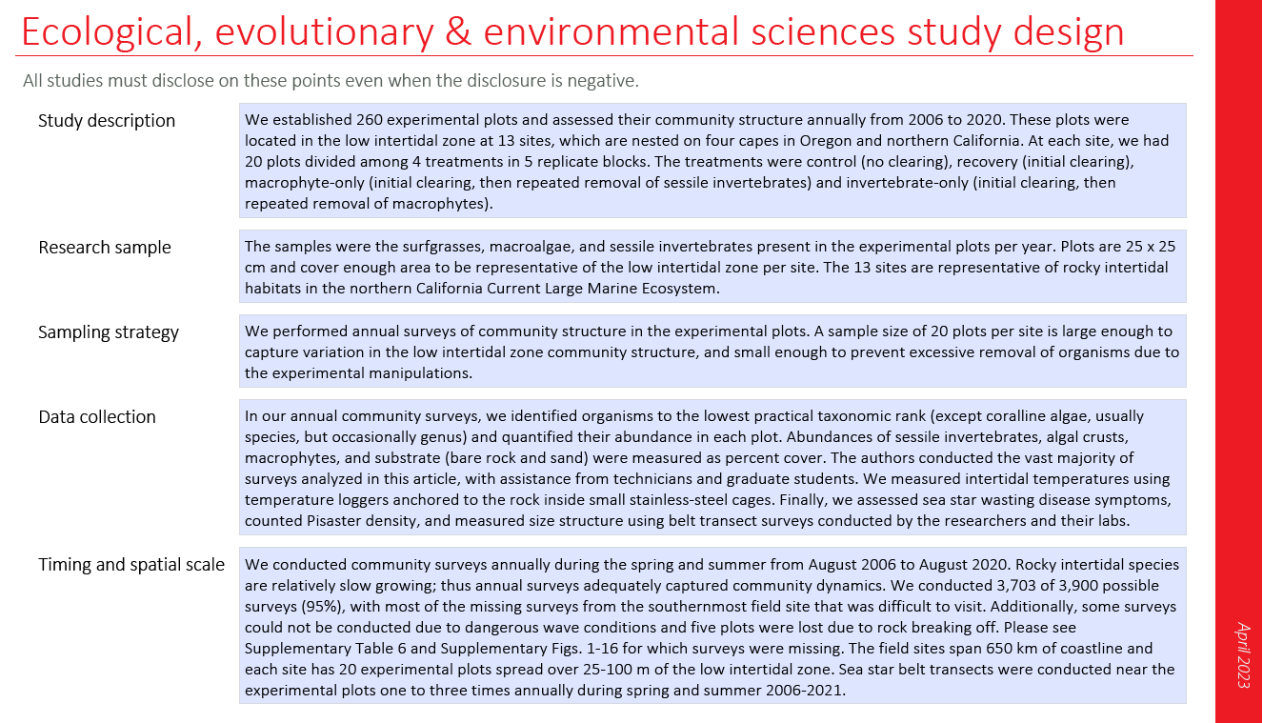

Slide 14
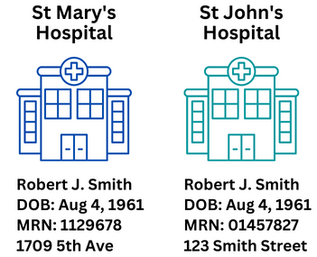
Ethics and Permissions
For subjects, were ethical standards met (e.g., IRB for humans, IACUC for vertebrates)?
Are data anonymized if necessary?
Are there restrictions on how the data can be used, shared, or published?

Slide 15
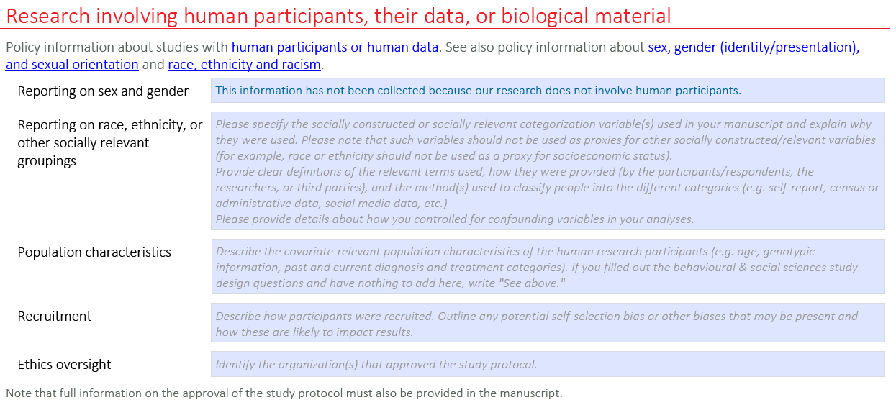

Slide 16
Publicly-available Environmental Datasets
US Government Open Data (https://data.gov/)
Archive of Data.gov (https://source.coop/repositories/harvard-lil/gov-data/description)
Environmental Data Initiative (https://edirepository.org/).
Data Observation Network for Earth (https://www.dataone.org/)
NASA Earth Science Data Systems (https://www.earthdata.nasa.gov/)
Historical climate data from Canada (https://climate.weather.gc.ca/)

Slide 17
Writing Quality Metadata
Metadata – data about data
Good data documentation includes:
The context of why and how the data were collected
The structure of the data, including how files relate to each other
A data dictionary used to catalog and provide meaningful descriptions for individually named data objects
Quality assurance that data are complete and accurate
Information on data confidentiality, access and use conditions
Identification and tracking of different versions of datasets

Slide 18
Metadata Examples
Best practices for metadata creation from USGS
How can these metadata be improved?
Title: Avian point count surveys on Steens Mountain
Method: Estimated birds up to 40 ms away for 5 mins
Location: Arroyo near Riddle Brothers Ranch
Time: April 2022
Species: Passerines including L. ludovicianus
Sampling strategy: Audio and visual detection
Sample size: 200

